Slide 1


Slide 2
Computer Vision for Medical Imaging with MatLab Practical Implementations For Beginners
Beril Sirmacek
b.sirmacek@utwente.nl
May 3, 2018
Notes:
Welcome to the computer vision lunch lecture for medical image applications using Matlab
Where we do practical implementations for beginners.
This is the second lecture of our lecture series and so far we have no plans about the third one. After this lecture, if you still feel like there are some topics which are not covered or you need deeper focus in some specific implementations, then please let me know. We can discuss and create content for the 3rd lecture.

Slide 3
Goals for today:
Learning very basics about deep learning
Introducing some useful deep learning implementation examples
Introducing some resources which might support your research in this area
Notes:
Our goals for today are…

Slide 4
You need:
Matlab 2017b
Toolboxes:
Image processing toolbox
Computer Vision Toolbox
Data/Slides from:
https://pydio.ram.ewi.utwente.nl/
Source code from:
https://github.com/bsirmacek

Slide 5
Content:
Some basics
Exercise 1 Using pre-trained neural networks
Exercise 2 Transfer learning
Discussion on learning from scratch
Useful resources and examples
Notes:
Here is our content

Slide 6
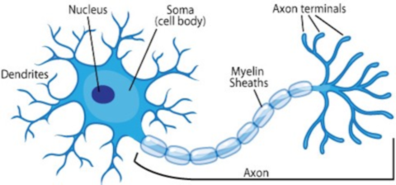
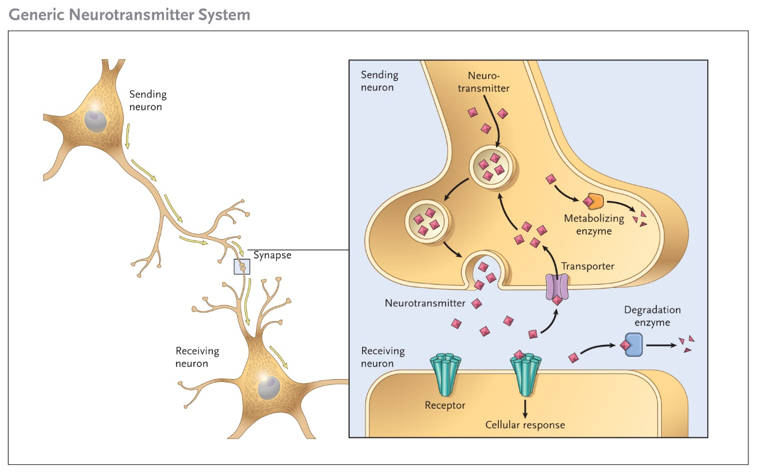
1. Some basics:
Notes:
Let’s start with some basics.

Slide 7
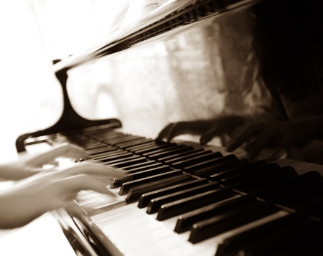
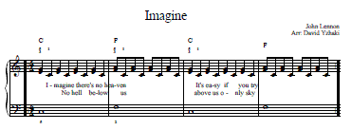
1. Some basics:

Slide 8
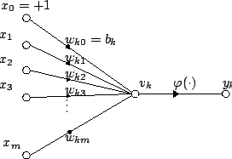
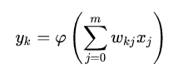
1. Some basics:
Notes:
Mathematically….

Slide 9

1. Some basics:
This is what a neuron can do, if the input is an image.
Notes:
This is what 1 neuron can do.
If we cascade the neurons as they are in brain, then we would have a convolutional neural network (CNN)

Slide 10

1. Some basics:
This is what cascade of neurons (CNN) can do.
image: https://goo.gl/dVSMQo
Notes:
This is what 1 neuron can do.
If we cascade the neurons as they are in brain, then we would have a convolutional neural network (CNN)
Generally there are pulling layers which subsample the data.
There are two reasons of subsampling.
1- Finding what is really representative and reducing the amount of data to be held to represent feature space. In other words, less number of weights to remember.
2- Achieving to a fully connected layer, so there could be a relationship mining in over all picture as well.
For instance, not only looking at this robot hand and deciding that it is a robot, instead looking at over all image and deciding that all these features around this input give significant values when they come together, their spatial relationship shows me that it looks like a robot.
That is the contribution of the fully connected layer or layers to make the CNN more intelligent. Maybe more intelligent than the neural networks that we have learned in 90s.

Slide 11

1. Some basics:
This is how a max pool layer looks like.
Notes:
This is what 1 neuron can do.
If we cascade the neurons as they are in brain, then we would have a convolutional neural network (CNN)
Generally there are pulling layers which subsample the data.
There are two reasons of subsampling.
1- Finding what is really representative and reducing the amount of data to be held to represent feature space. In other words, less number of weights to remember.
2- Achieving to a fully connected layer, so there could be a relationship mining in over all picture as well.
For instance, not only looking at this robot hand and deciding that it is a robot, instead looking at over all image and deciding that all these features around this input give significant values when they come together, their spatial relationship shows me that it looks like a robot.
That is the contribution of the fully connected layer or layers to make the CNN more intelligent. Maybe more intelligent than the neural networks that we have learned in 90s.

Slide 12
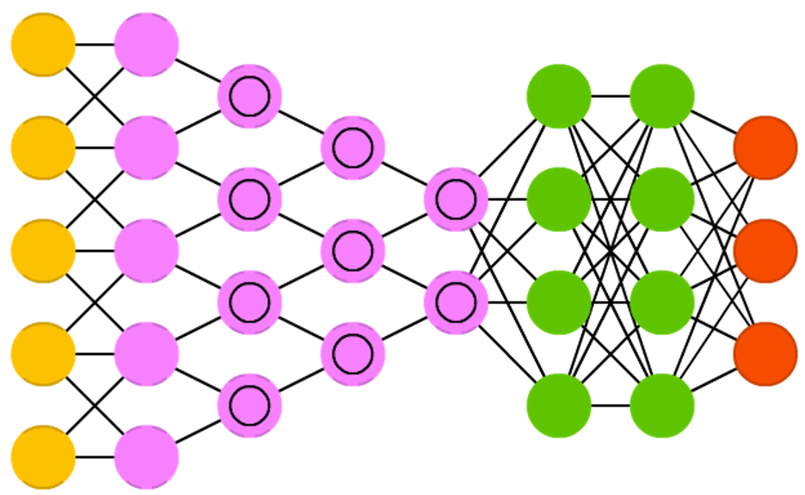
1. Some basics:
CNN architecture
Notes:
So the network architecture looks like this.

Slide 13
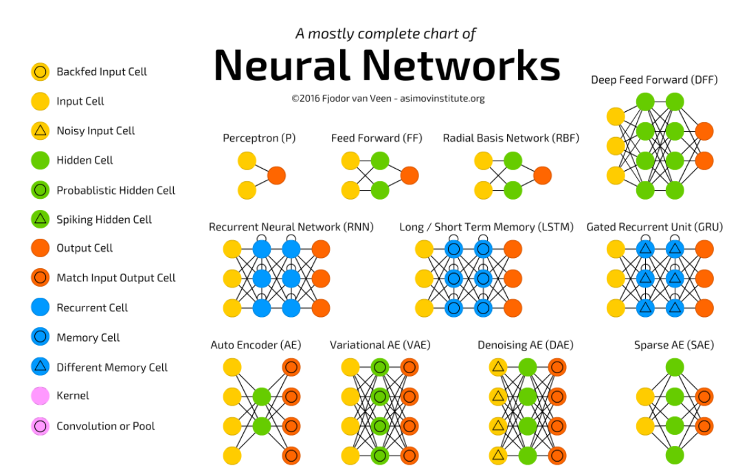
1. Some basics:
http://www.asimovinstitute.org/neural-network-zoo/

Slide 14

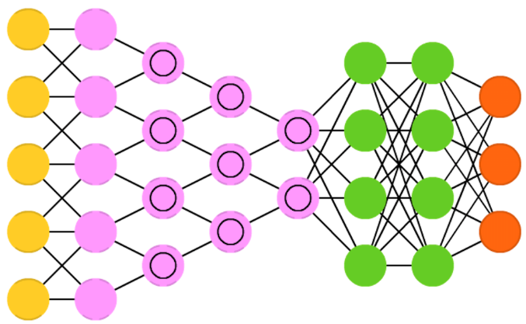

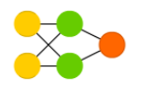
1. Some basics:
Chihuahua
Chihuahua
classification
CNN architecture
Feature extraction
Difference between deep learning (left) and the classical machine learning algorithms (right).
Notes:
So the network architecture looks like this.

Slide 15
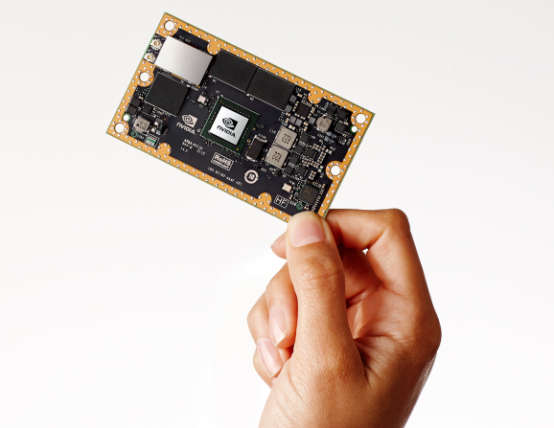
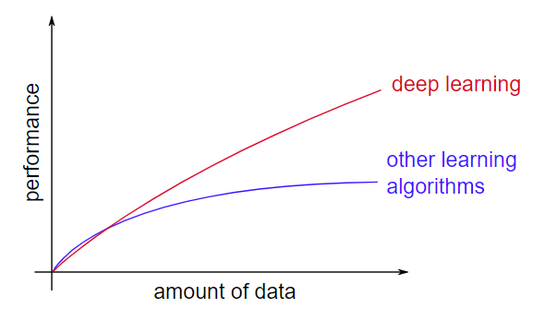
1. Some basics:
Notes:
More understanding of how convolutional layers behave
More labelled training data
More computational power
Opensource tools ans models

Slide 16
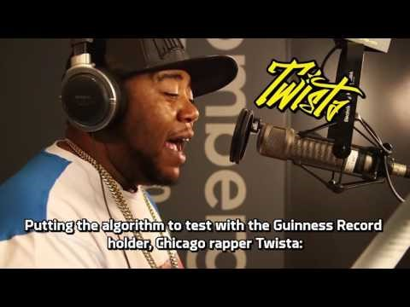
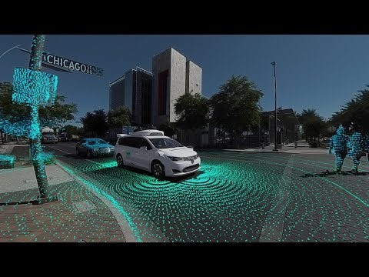
1. Some basics:
Lyrics created by neural networks
(trained by existing rap songs’ content and rhyming words)
Self driving cars assisted by neural networks
(trained to classify surrounding objects in 3D space in real-time)

Slide 17


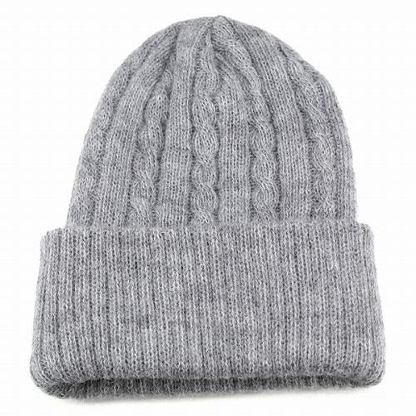
1. Some basics:
5.99 Euro

Slide 18
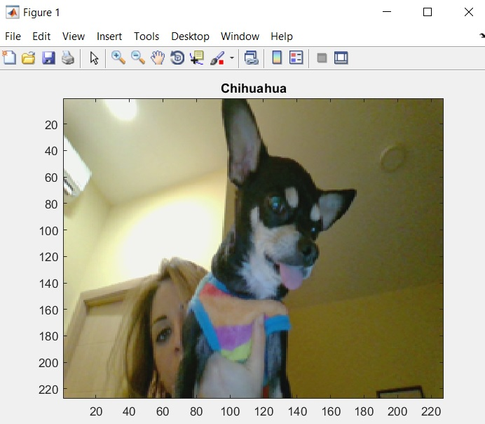
2. Exercise 1 Using pre-trained neural networks
Using AlexNet in Matlab
Notes:
You can try Google net in matlab as well.
Those provide matlab packages, there are also other networks which provide APIs to make calls from matlab.

Slide 19
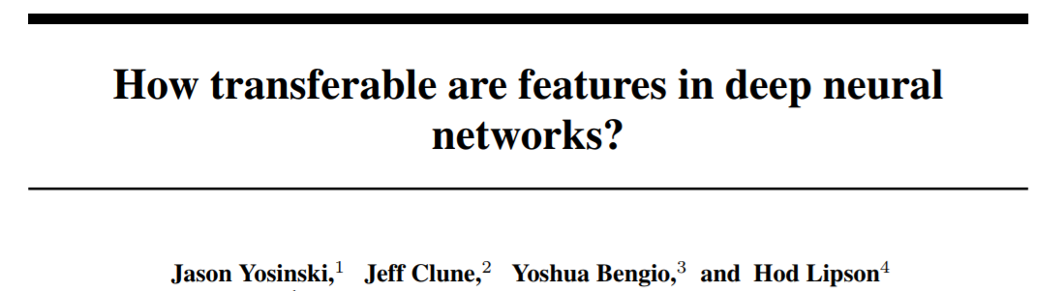
3. Exercise 2 Transfer learning
Why transfer learning?
When there is not sufficient data to train a neural network from scratch
When there is not enough time (days / weeks) to train a neural network from scratch
When there are good layers which could be used (a dog breed classifier can benefit from layers which are trained to classify dogs)
Allows people to share/exchange layers (trained network models)
Caffe has a model zoo where people share the network weights https://github.com/BVLC/caffe/wiki/Model-Zoo

Slide 20

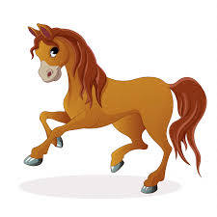
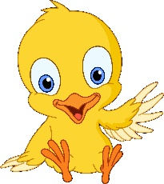
3. Exercise 2 Transfer learning

Slide 21
3. Exercise 2 Transfer learning
OTHER
Depends on number of classes in the output
Add/remove feature extraction layers if needed
Replace with new layers and retrain

Slide 22
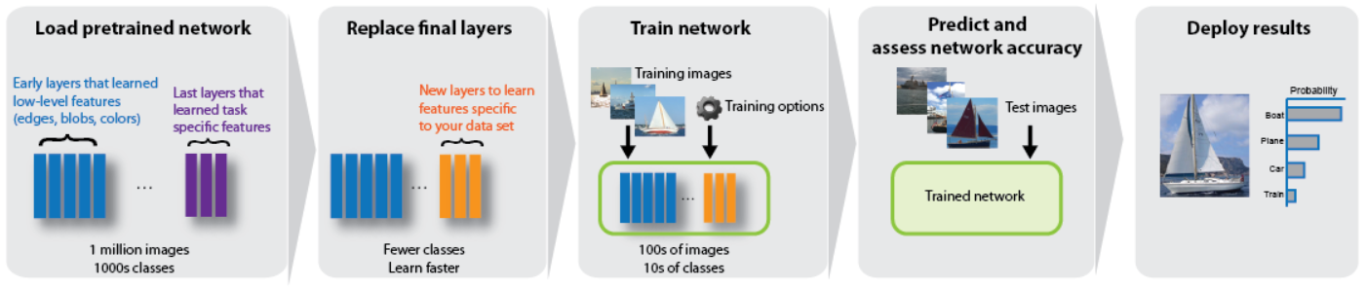
3. Exercise 2 Transfer learning

Slide 23
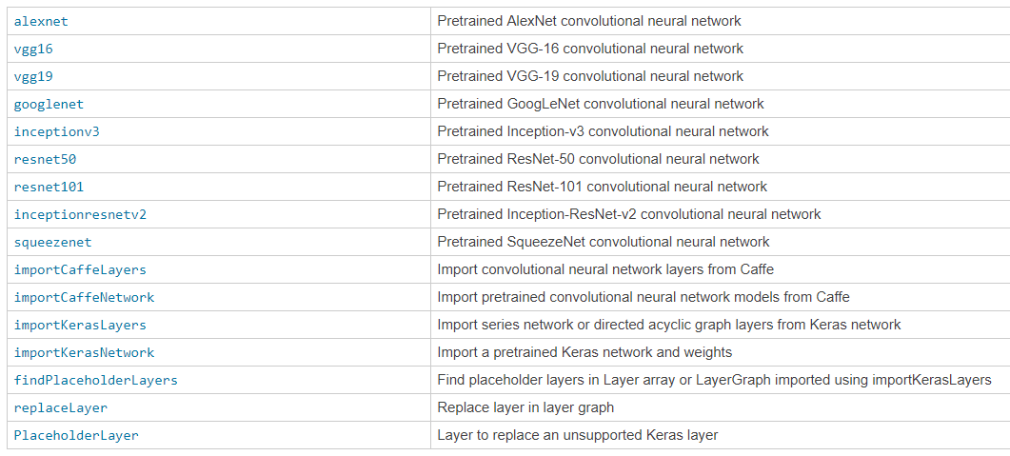
3. Exercise 2 Transfer learning
Useful pre-trained networks and layers accessible with Matlab functions

Slide 24
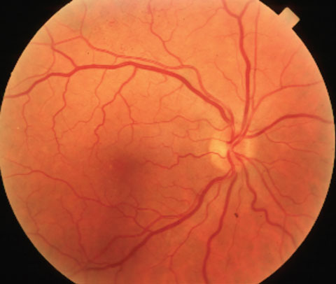
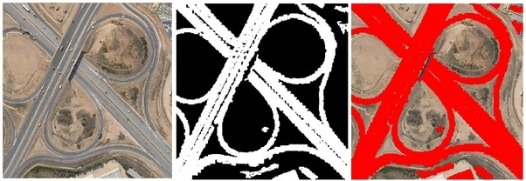
3. Exercise 2 Transfer learning
Retina image
(Vessel network)
Satellite image
(Road network)
Useful pre-trained networks and layers accessible with Matlab functions

Slide 25
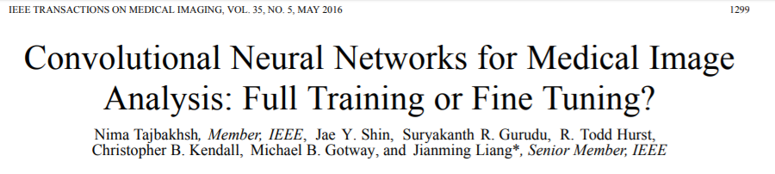
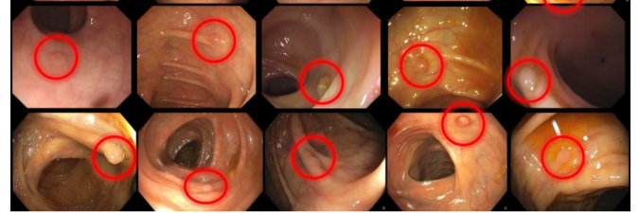
4. Discussion on learning from scratch

Slide 26
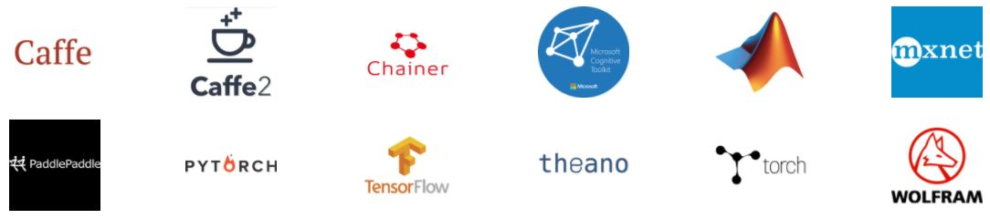
5. Useful resources and examples
Deep learning frameworks offer building blocks for designing, training and validating deep neural networks, through a high level programming interface.
Widely used deep learning frameworks such as Caffe2, Cognitive toolkit, MXNet, PyTorch, TensorFlow and others rely on GPU-accelerated libraries such as cuDNN and NCCL to deliver high-performance multi-GPU accelerated training.

Slide 27
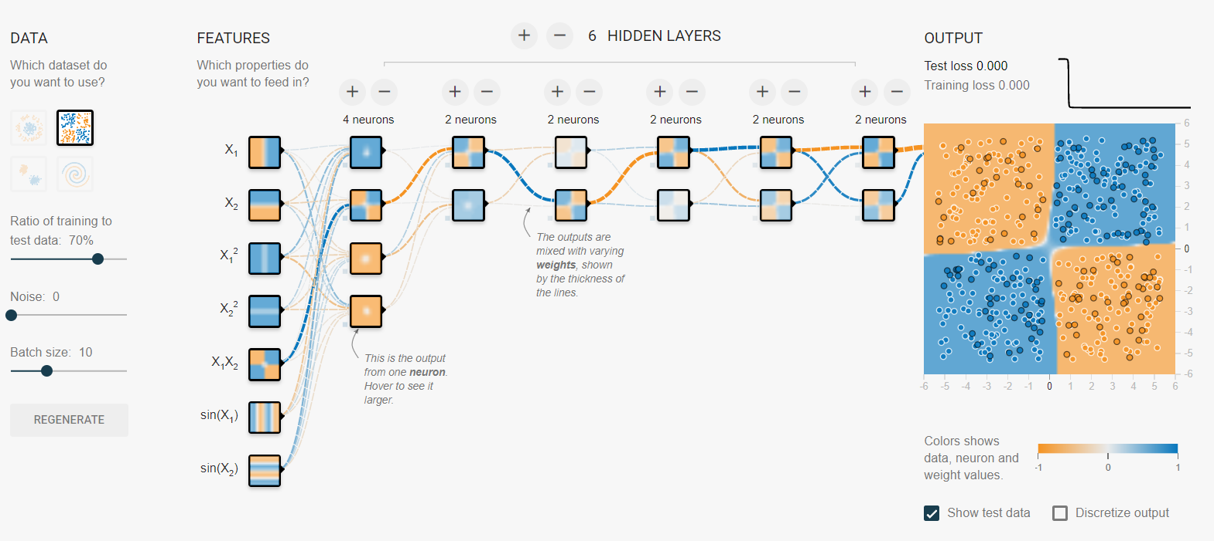
5. Useful resources and examples
https://playground.tensorflow.org

Slide 28

5. Useful resources and examples
https://js.tensorflow.org/

Slide 29
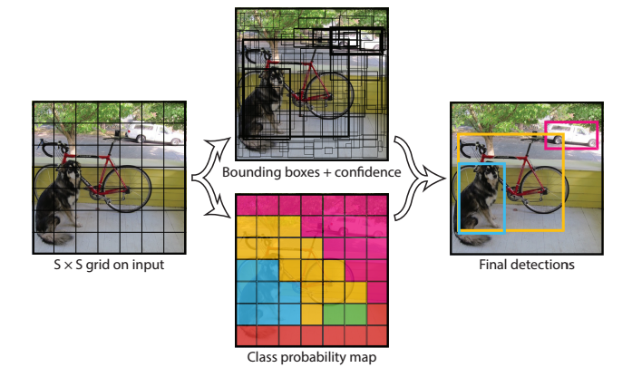
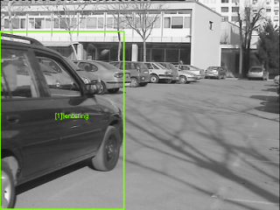
5. Useful resources and examples
https://pjreddie.com/darknet/yolo/

Slide 30





5. Useful resources and examples
Network Structure : Liver Detection
Input Image
Info: 256x256x1
Max Pooling
Info: 3, s2
Input : 123x123x64
Output : 61x61x64
Max Pooling
Info: 3, s2
Input : 61x61x128
Output : 30x30x128
Max Pooling
Info: 3, s2
Input : 30x30x256
Output : 14x14x256
Max Pooling
Info: 3, s2
Input : 14x14x512
Output : 6x6x512
Fully connected layer
Info: in 18432 out 4096
1. Convolution Layer
Info: (11, 64, s2)
2. Normalization Layer
3. ReLu Layer
Input : 256x256x1
Output : 123x123x64
1. Convolution Layer
Info: (5, 128, p2, s1)
2. Normalization Layer
3. ReLu Layer
Input : 61x61x64
Output : 61x61x128
1. Convolution Layer
Info: (3, 256, p1, s1)
2. Normalization Layer
3. ReLu Layer
Input : 30x30x128
Output : 30x30x256
1. Convolution Layer
Info: (3, 512, p1, s1)
2. Normalization Layer
3. ReLu Layer
Input : 14x14x256
Output : 14x14x512
Fully connected layer
Info: in 4096 out 16
Classification Layer
Info: Background or Liver
Fully connected layer
Info: in 16 out 2

Slide 31
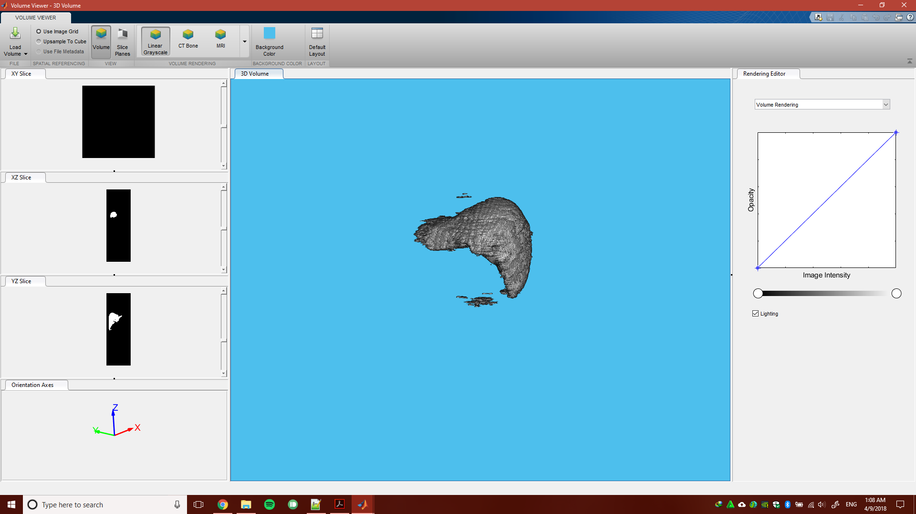
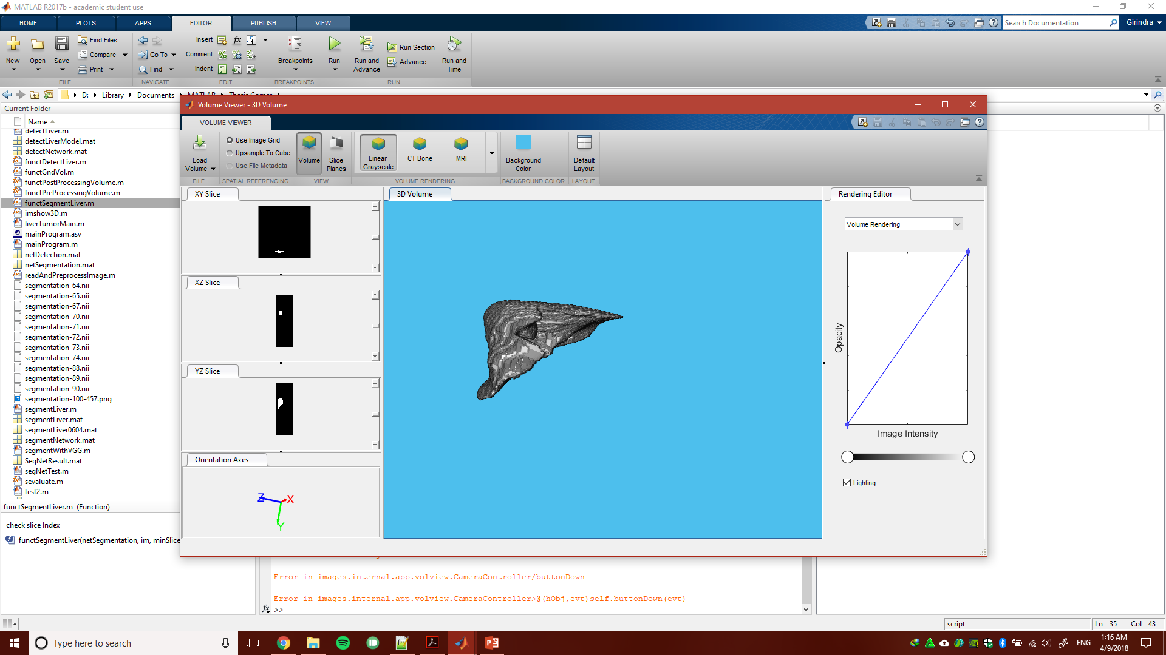
Segmentation result
5. Useful resources and examples

Slide 32
Post Processing Volume
Thank you!
Questions?
Construct volume of 1 patient
Select the largest connected volume

